Slide 1
National Citizens Survey
November 9, 2020

Slide 2
National Citizen Survey
Citizen surveys conducted in 2020, 2018, 2016, 2011, 2009, 2007, 2005
Mail survey to 1,700 randomly selected residents: 480 responses, 5% margin of error.
Conducted in July 2020
Standard survey template used by more than 500 jurisdictions nationwide.
Ability to make comparisons between our survey responses and other cities.
Comparisons not necessarily relative to all cities, only those who have taken the National Citizen Survey.

Slide 3
Highlights
Twenty-nine Indicators Higher than the National Benchmark Average
Twenty-two Indicators Higher than our 2018 Citizen Survey
Eight Indicators Lower than our 2018 Citizen Survey

Slide 4
Comparisons to National Benchmarks
Overall Economic Health of City
Overall Image or Reputation of City
Overall Direction of City
Honesty and Acting in the Best Interest of the Community

Slide 5
Improvements from 2018
Overall Direction of the City
Value of Services for Taxes Paid
O’Fallon as a Place to Work
Quality of Businesses and Vibrancy of Downtown

Slide 6
Overall Quality of Life

Slide 7
Overall Quality of City Services

Slide 8
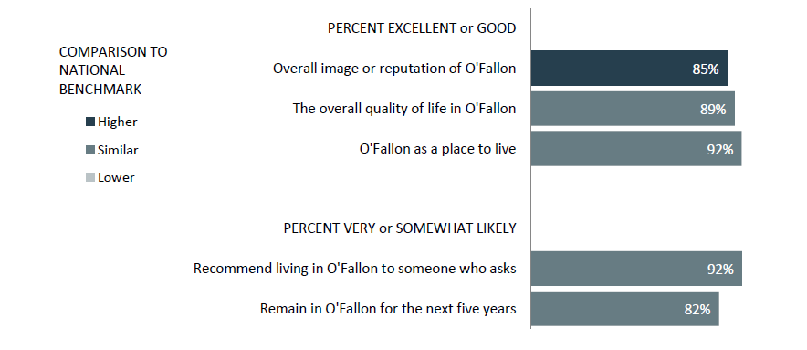
Quality of Life Comparisons

Slide 9
Governance Comparisons

Slide 10
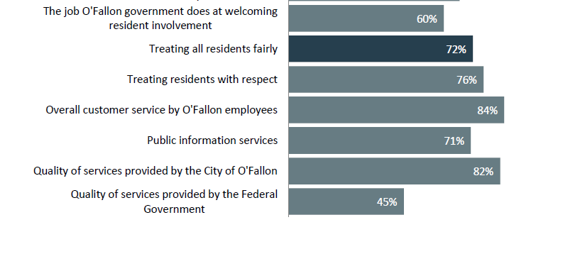
Governance Comparisons

Slide 11
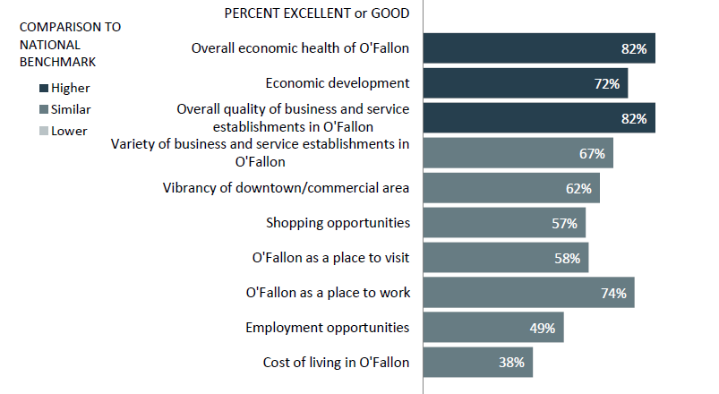
Economy Comparisons

Slide 12
Quality of Public Safety Services

Slide 13
Quality of Public Safety Services

Slide 14
Quality of Public Safety Services

Slide 15
Crime Prevention
Above Benchmark

Slide 16
Quality of Leisure Services

Slide 17
Quality of Leisure Services

Slide 18
Quality of Leisure Services

Slide 19
Quality of Library Services

Slide 20
Quality of Public Works Services

Slide 21
Quality of Public Works Services

Slide 22
Quality of Public Works Services

Slide 23
Quality of Public Works Services

Slide 24
Quality of Planning Services

Slide 25
Quality of Planning Services

Slide 26
Resident Priorities

Slide 27
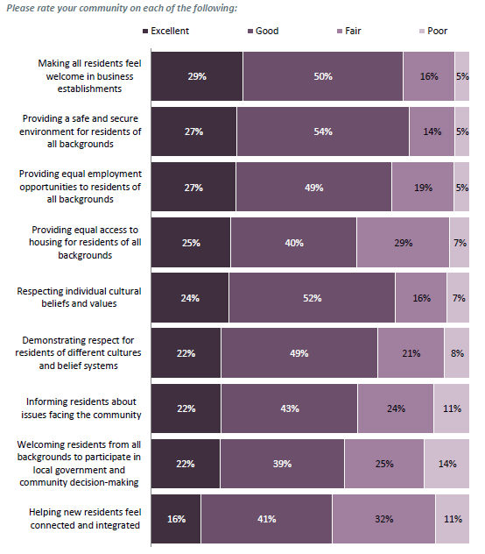
Resident Priorities

